Slide 1


Eshwanth
09/07/202

Slide 2

S.No | Content | Page
1 | Executive Summary | 3
2 | Introduction | 5
3 | Methodology | 7
4 | Results EDA with Visualization EDA with SQL Interactive Maps Plotly Dash Dashboard Predictive Analytics | 17
5 | Conclusion | 46
Contents

Slide 3
Summary of methodologies
The objective of the research is to identify the factors for a successful rocket landing. To make this determination, the following methodologies were used:
Data gathering using SpaceX REST API and web scraping techniques
Data Wrangling to create success/fail outcome variable
Exploratory data analysis
Using visualization for payload, launch site, flight number and yearly trend
Using SQL total payload, payload range and outcomes
Data visualization of launch site success rates and proximity to geographical markers
Data visualization of the launch sites with the most success and successful payload ranges
Modeling data to predict landing outcomes using logistic regression, support vector machine(SVM), decision tree and K-nearest neighbor (KNN)
Executive Summary

Slide 4

Executive Summary
Results
Exploratory Data Analysis:
Launch success has improved over time
KSC LC-39A has the highest success rate among landing sites
Orbits ES_L1, GEO, HEO and SSO have a 100% Success rate
Visualization/Analytics:
All the launch sites are situated in proximity to the coast, with the majority being situated near the equator
Predictive Analytics
The accuracy of all the models were similar with the decision tree being slightly more accurate

Slide 5

Introduction
SpaceX, a pioneering leader in the aerospace industry, is dedicated to making space travel affordable for all. Their impressive achievements include launching spacecraft to the International Space Station, deploying a satellite constellation to provide global internet access, and conducting manned space missions. One key to SpaceX's success is the relatively low cost of their rocket launches, priced at $62 million per launch, thanks to their innovative reuse of the Falcon 9 rocket's first stage. In contrast, other providers, unable to reuse their first stages, incur costs upwards of $165 million per launch. By predicting whether the first stage can be successfully landed and reused, we can accurately estimate the launch costs. To achieve this, we will utilize publicly available data and machine learning models to forecast the reusability of the first stage for SpaceX and other competing companies.

Slide 6

Objectives
Relation between the successful landing of the first stage and factors like payload mass, location of launch site, number of flights and orbits
Rate of successful landings over time
Find out the best model to predict successful landing

Slide 7

Methodology
Executive Summary
Data collection methodology:
SpaceX REST API
Web scraping
Data wrangling
Filtered Data
Handled Missing values
Applied one hot encoding
Exploratory data analysis (EDA) using visualization and SQL
Interactive visual analytics using Folium and Plotly Dash
Predictive analysis using classification models

Slide 8
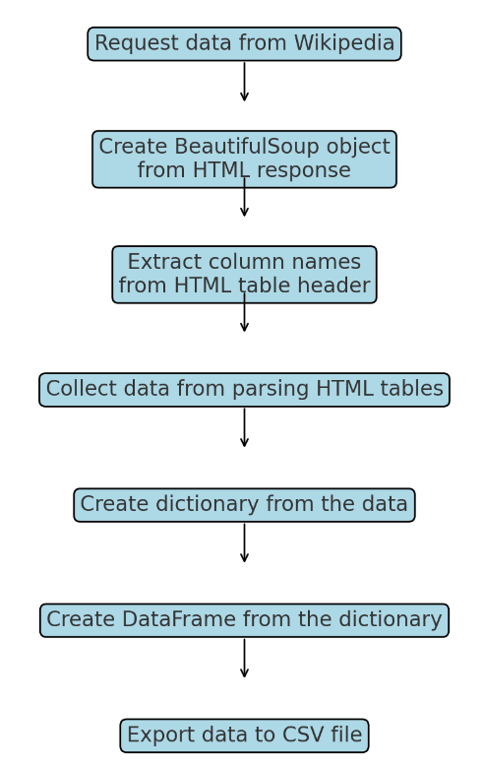
Data Collection – Scraping
This process involves fetching data from the SpaceX API to gather information on their rocket launches. The API response is parsed and converted into a structured DataFrame format. Custom functions are used to extract detailed launch information, which is then organized into a dictionary and subsequently built into a DataFrame. The DataFrame is filtered to include only Falcon 9 launches, and any missing values in the Payload Mass column are replaced with the mean value. Finally, the cleaned and processed data is exported to a CSV file for further analysis and reporting.
View on Github

Slide 9
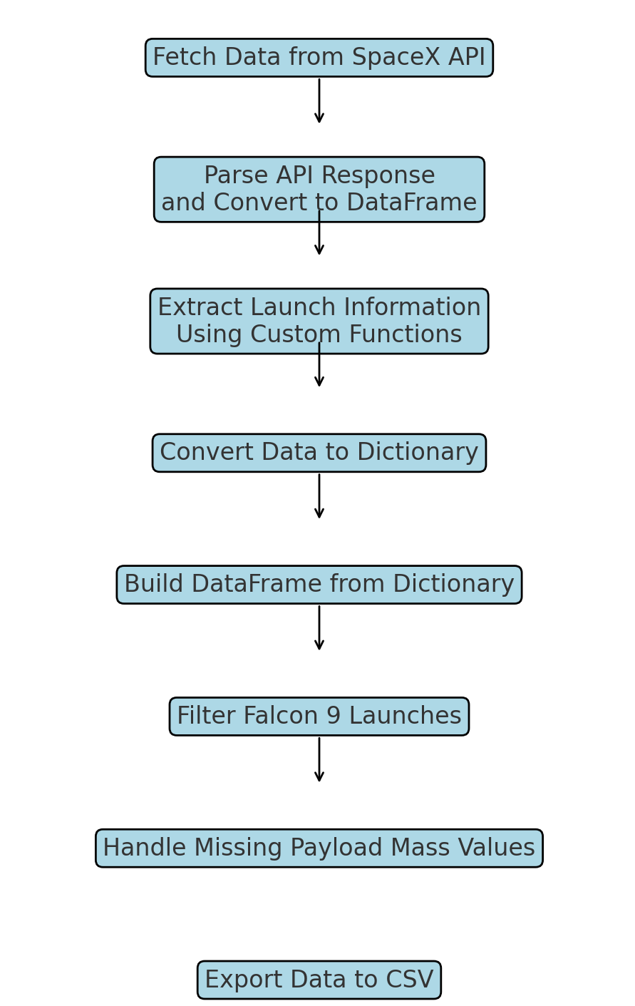
Data Collection – SpaceX API
This process involves retrieving data from Wikipedia by making an HTTP request. The HTML response is parsed using BeautifulSoup to extract the relevant HTML tables. Column names are obtained from the table headers, and the data is collected by parsing these tables. The extracted data is then organized into a dictionary, which is subsequently converted into a DataFrame. Finally, the DataFrame is exported to a CSV file for further analysis or reporting.
View on Github

Slide 10
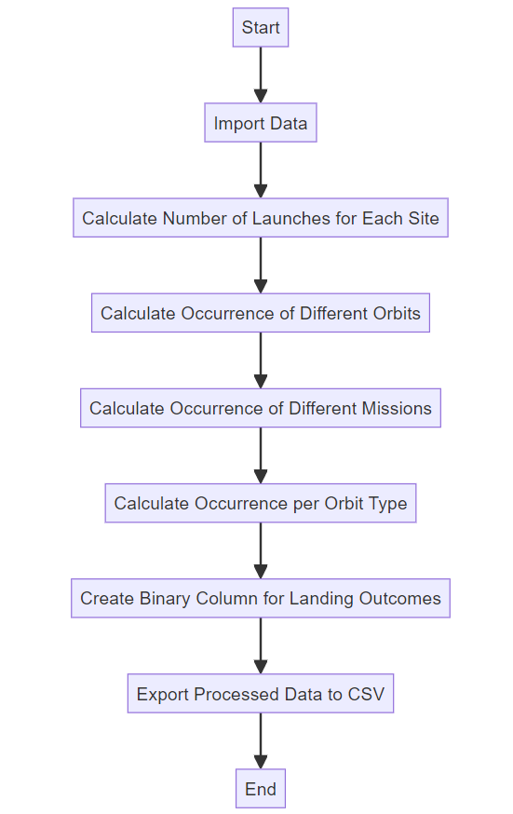
Data Wrangling
This process involves performing exploratory data analysis (EDA) to determine various data labels. The steps include calculating the number of launches for each site, the occurrence of different orbits, the occurrence of different missions, and the occurrence per orbit type. Additionally, a binary column for landing outcomes is created. The final step is to export the processed data to a CSV file for further analysis or reporting.
View on Github

Slide 11

EDA with Data Visualization
In this process the relationship between variables was explored to identify dependent variables for using in the model.
Visuals plotted
Flight Number vs Payload
Flight Number vs Launch Site
Payload Mass (Kg) vs Launch Site
Payload Mass (Kg) vs Orbit Type
View on Github

Slide 12
EDA with SQL
This process includes extracting unique values, filtering records based on specific conditions, and performing aggregate operations like sum and average to summarize data attributes. For instance, SQL queries can be used to identify unique launch sites, filter launches starting with a certain prefix, calculate total and average payload masses for specific missions or booster versions, and determine the dates and outcomes of specific events like successful landings. Through such queries, SQL enables a comprehensive exploration and preliminary analysis of the data, revealing patterns, anomalies, and insights that guide further analysis.
View on Github

Slide 13

Build an Interactive Map with Folium
In this report, an interactive map has been developed to visualize key space exploration data. Key features include:
A blue circle marking NASA Johnson Space Center's coordinates with a popup label displaying its name.
Red circles at all launch site coordinates, each with popup labels showing their respective names.
Colored markers at each launch site to indicate the success and failure of launches, enabling quick identification of sites with high success rates.
Colored lines showing the distances between the launch site CCAFS SLC-40 and the nearest coastline, railway, highway, and city, providing geographic context and accessibility insights.
These enhancements facilitate a comprehensive and user-friendly exploration of space launch data.
View on Github

Slide 14
In this dashboard, several interactive features have been integrated to provide a comprehensive analysis of launch data. A dropdown list allows users to select either all launch sites or a specific one for detailed analysis. A pie chart visually represents the proportion of successful launches, with options to view both successful and unsuccessful launches as a percentage of the total. A slider enables users to filter data based on payload mass range, enhancing the granularity of the analysis. Additionally, a scatter chart displays the correlation between payload mass and success rates by booster version, allowing users to explore the relationship between payload and launch success. These interactive elements provide a dynamic and user-friendly interface for analyzing complex launch data.
View on Github
Build a Dashboard with Plotly Dash

Slide 15
Predictive Analysis (Classification)
The process begins with creating a NumPy array from the Class column. The data is then standardized using StandardScaler to ensure consistent scaling across features. After standardization, the dataset is split into training and testing sets using ‘train_test_split’. A GridSearchCV object is created with ‘cv=10’ to optimize model parameters through cross-validation. This grid search is applied to various algorithms, including logistic regression, support vector machine, decision tree and k-nearest neighbor, to find the best parameters for each. The accuracy of each model is calculated on the test data, and the confusion matrix is assessed to evaluate model performance comprehensively. Finally, the best model is identified using Jaccard_Score, F1_Score, and Accuracy metrics, ensuring a robust selection based on multiple evaluation criteria
View on Github

Slide 16

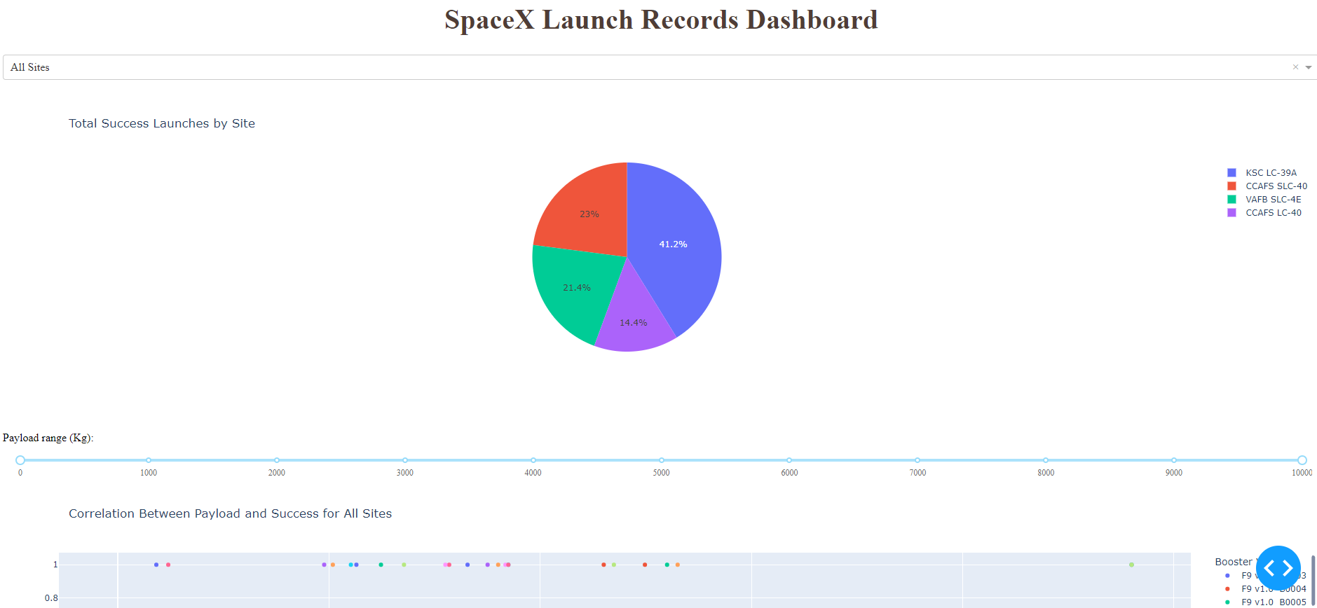
Results
Exploratory data analysis
Launch Success has improved over time
KSC LC-39A has the highest success rate among landing sites
Orbits ES-L1, GEO, HEO and SSO have a 100% success rate
Predictive analysis
Decision Tree model is the best predictive model for the dataset
Visual Analytics
Most launch sites are near the equator, and all are close to the coast
Launch sites are far enough away from cities, highway and railways, a failed launch can damage while still in proximity to bring people and material to support launch activities

Slide 17

Section 2

Slide 18
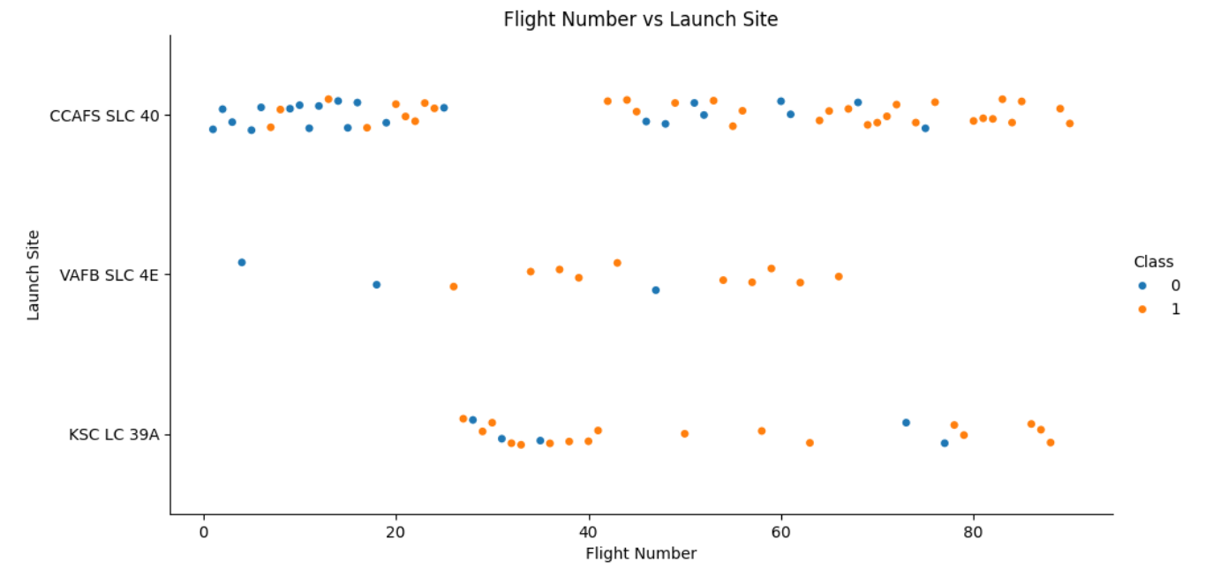
Flight Number vs. Launch Site
Inference
Earlier flights had a lower success rate
Later flights had a higher success rate
Around half of launches were were CCAFS SLC 40 launch site
VAFB SLC 4E and KSC LC 39A have higher success rates
We can infer that new launches have a higher success rate

Slide 19
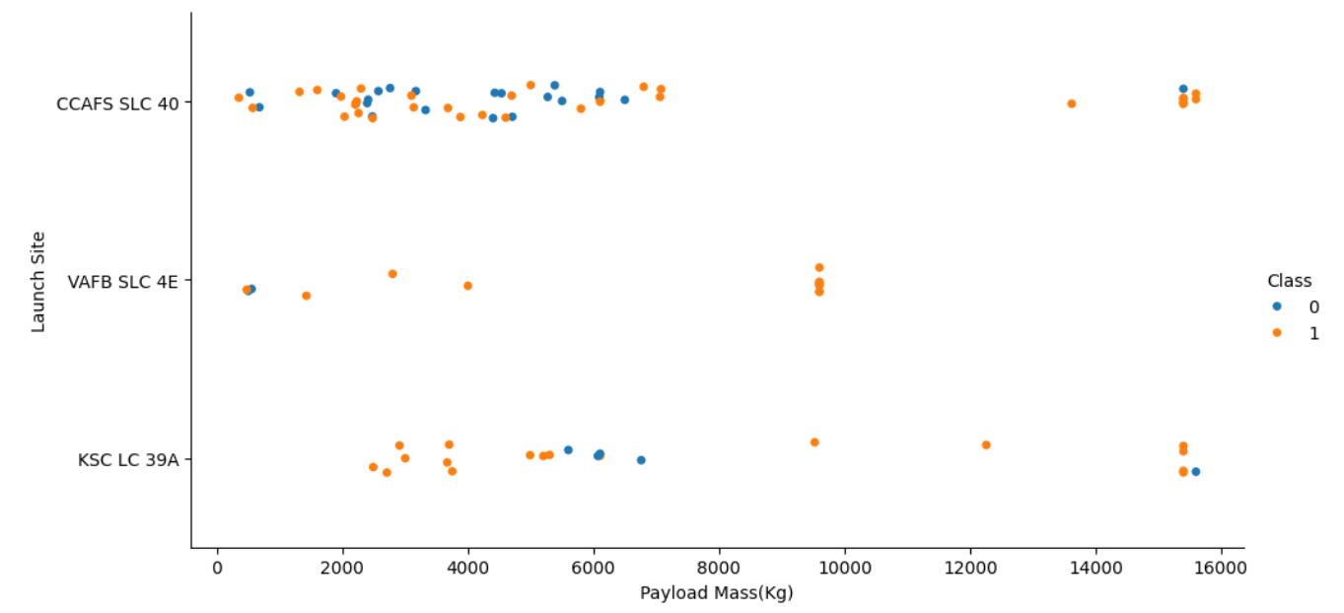
Payload vs Launch site
Inference
Typically, the higher the payload mass(kg), the higher the success rate
Most launches with a payload greater than 7,000 kg were successful
KSC LC 39A has a 100% success rate for launches less than 5,500 kg
VAFB SKC 4E has not launched anything greater than ~ 10, 000 Kg

Slide 20
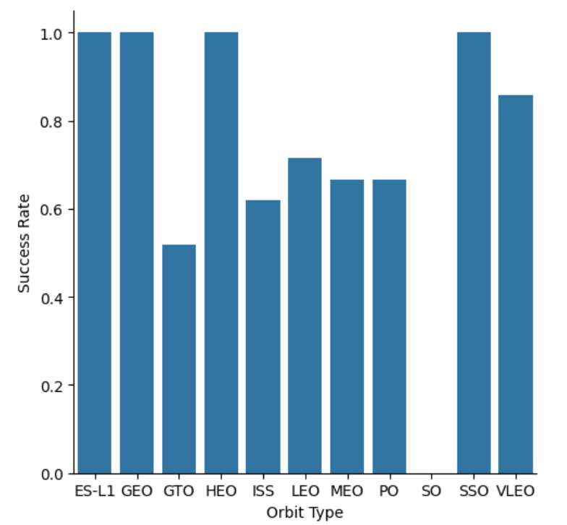
Success Rate vs. Orbit type
Inference
100% Success rate: ES-L1, GEO, HEO and SSO
50%-80% Success Rate: GTO, ISS, LEO, MEO, PO
0% Success Rate: SO

Slide 21
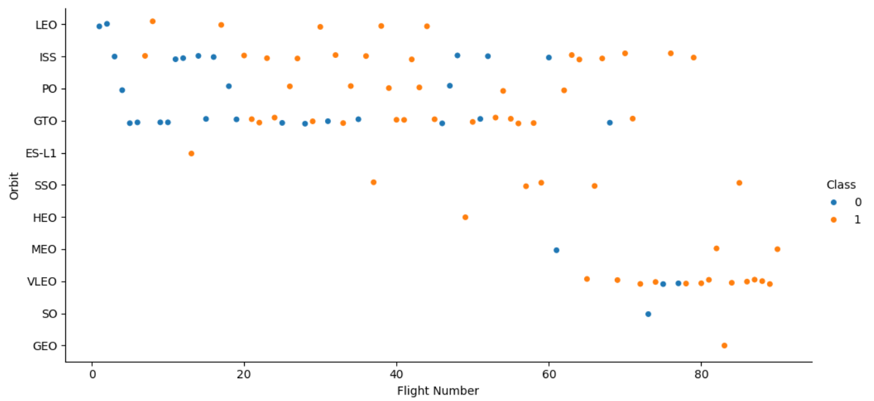
Flight Number vs. Orbit type
Inference
The Success rate typically increases with the number of flights for each orbit
This relationship is highly apparent for the LEO orbit
The GTO orbit, however, does not follow this trend

Slide 22
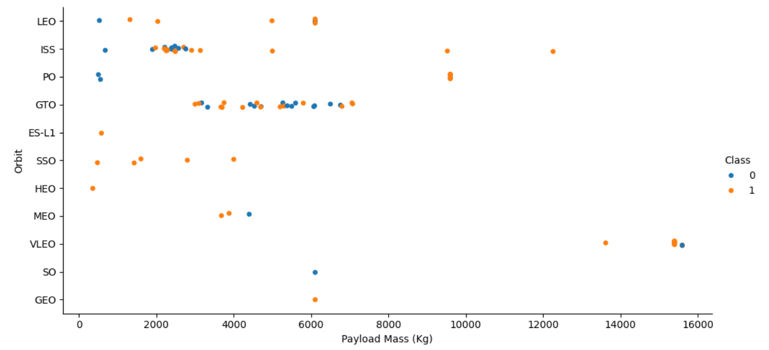
Payload vs. Orbit
Inference
Heavy payloads are better with LEO, ISS and PO orbits
The GTO orbit has mixed success with heavier payloads

Slide 23
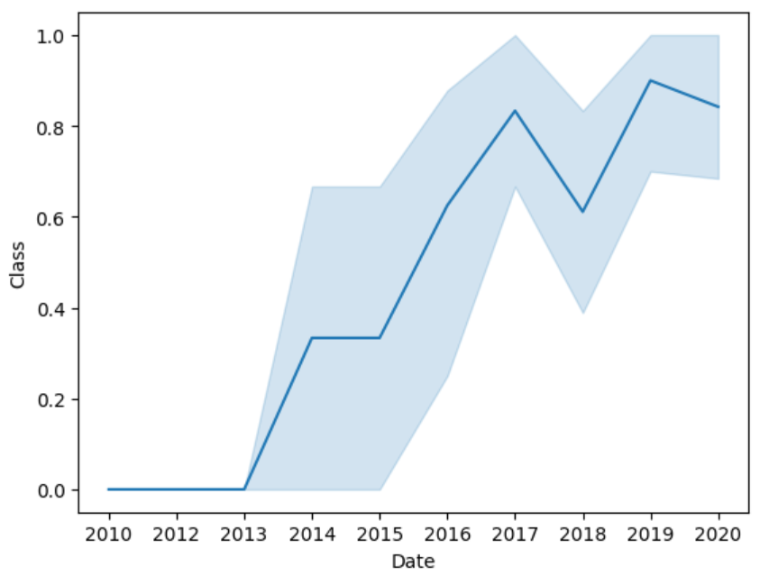
Launch Success Yearly Trend
Inference
The success rate improved from 2013-2017 and 2018-2019
The success rate decreased from 2017-2018 and from 2019-2020
Overall, the success rate has improved since 2013

Slide 24
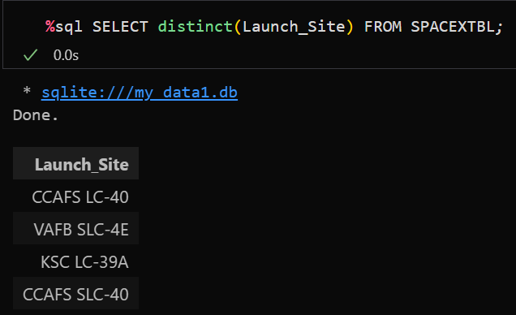
All Launch Site Names

Slide 25
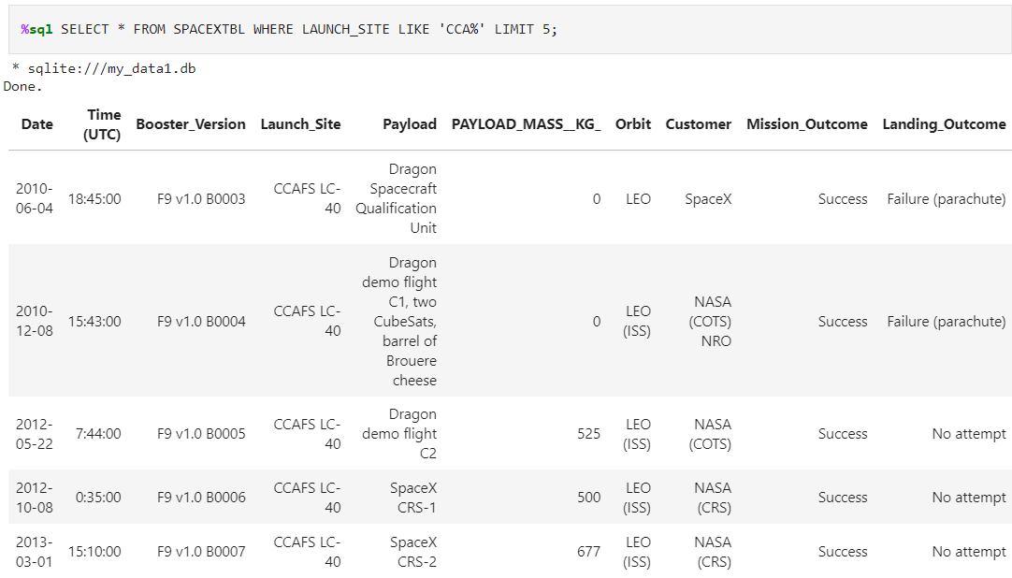
Launch Site Names that Begin with 'CCA'

Slide 26
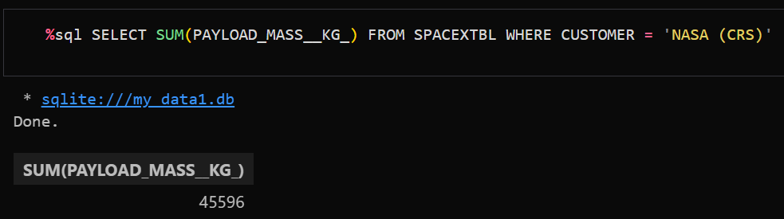
Total Payload Mass
Total Payload Mass
45,596 Kg in total carried by boosters launched by NASA (CRS)

Slide 27
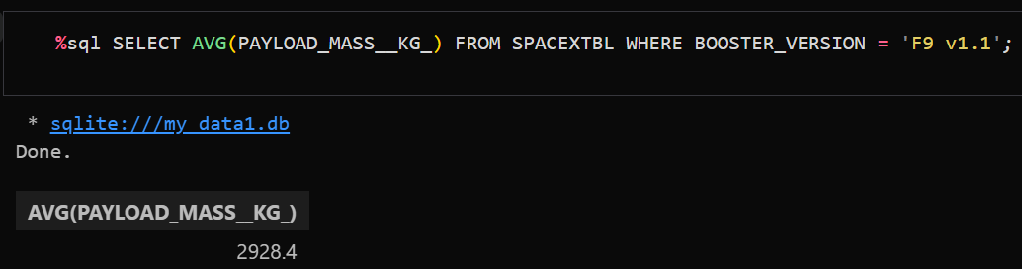
Average Payload Mass by F9 v1.1
Average Payload Mass
2,928 Kg carried by booster Version F9 v1.1

Slide 28
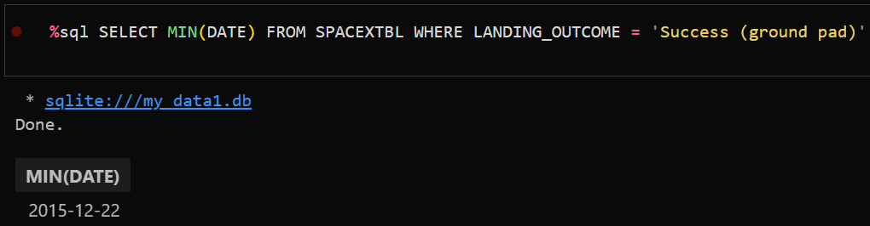
First Successful Ground Landing Date
The first successful landing in Ground Pad happened on 12/22/2015

Slide 29
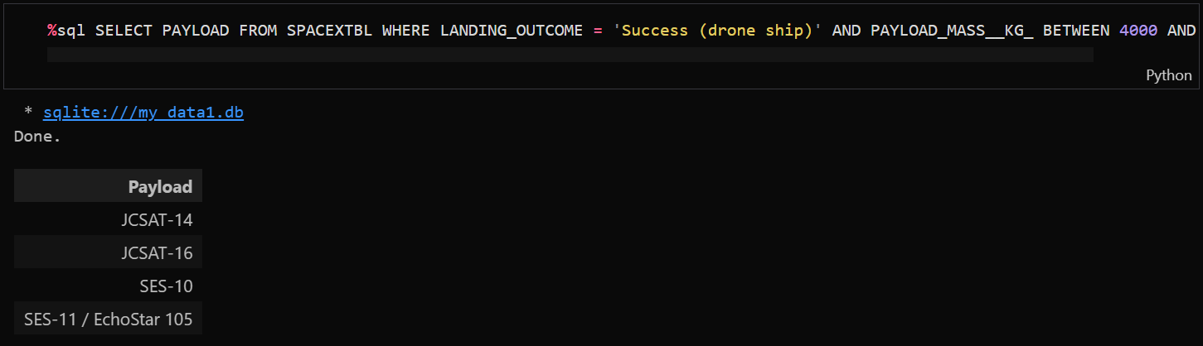
Successful Drone Ship Landing with Payload between 4000 and 6000
The boosters which have successfully landed on drone ship and had payload mass greater than 4000 but less than 6000
JSCAT-14
JSCAT-16
SES-10
SES-11/EchoStar 105

Slide 30
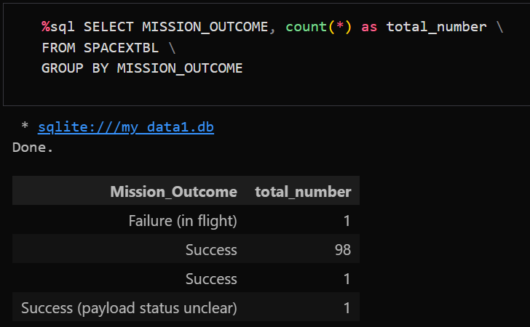
Total Number of Successful and Failure Mission Outcomes
99 of the Mission outcomes were successful
1 of the Mission outcomes resulted in failure
1 of the Mission is a success but the status of the payload is unclear

Slide 31
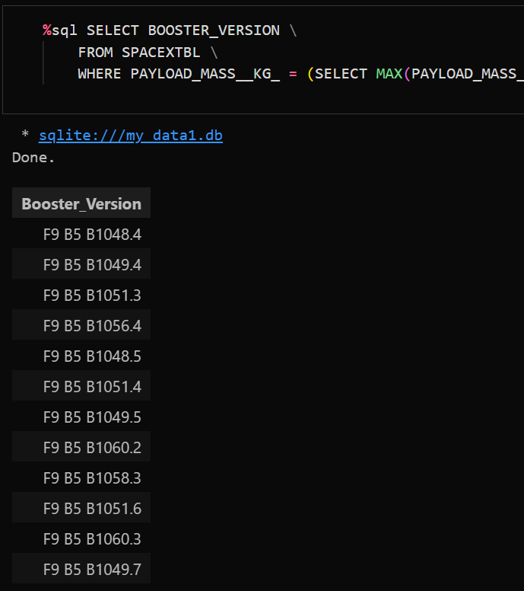
Boosters Carried Maximum Payload

Slide 32
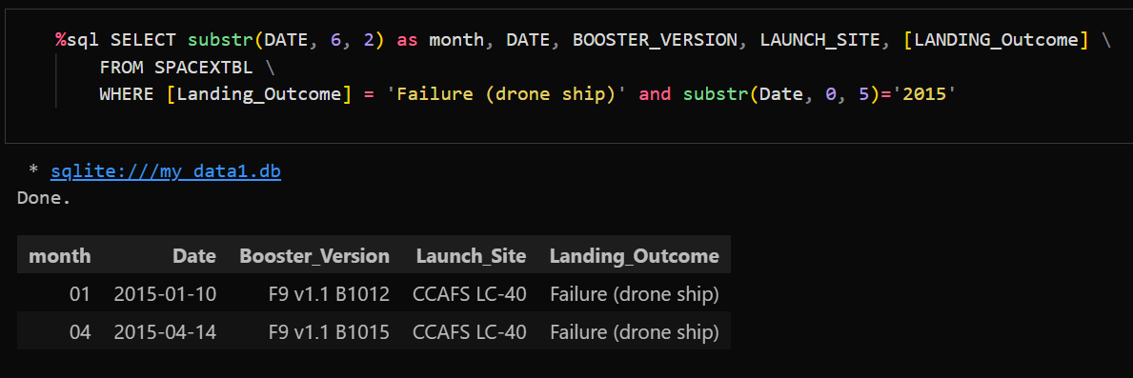
2015 Launch Records
List the failed landing_outcomes in drone ship, their booster versions, and launch site names for in year 2015
Present your query result with a short explanation here

Slide 33
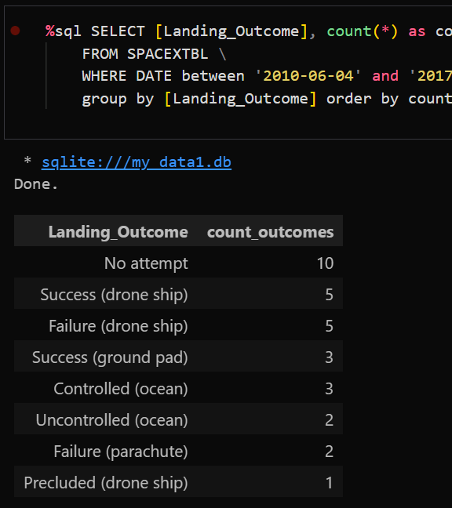
Rank Landing Outcomes Between 2010-06-04 and 2017-03-20

Slide 34

Section 3

Slide 35
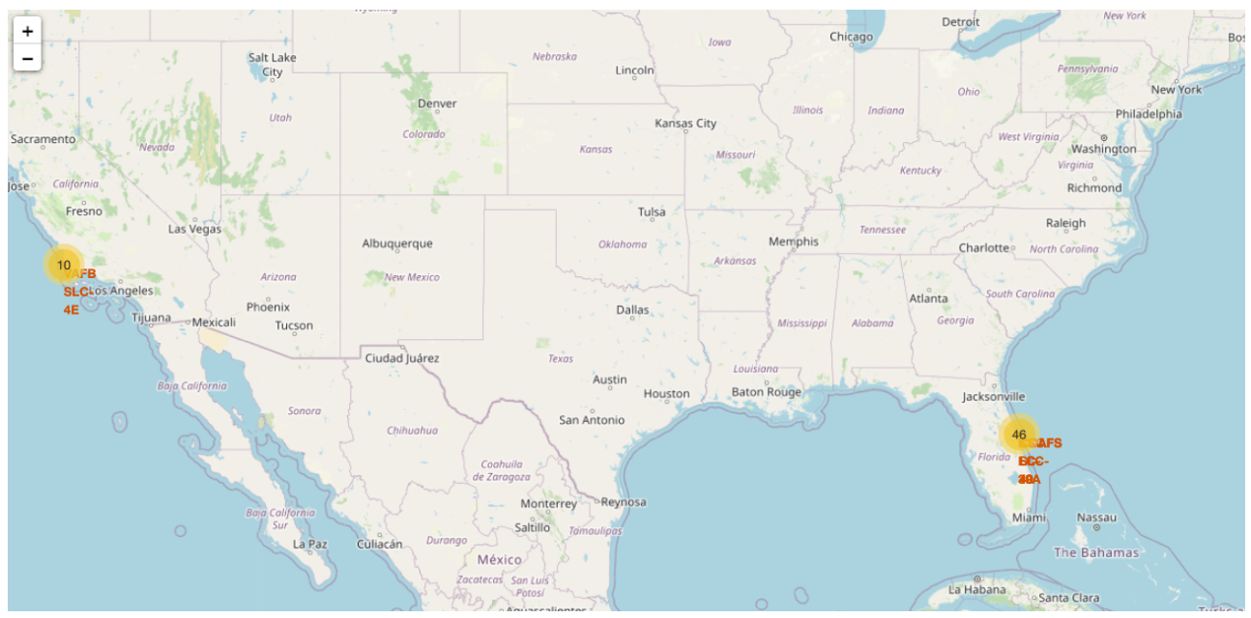
Launch Sites
Inference Launch sites closer to the equator benefit from the Earth's rotational speed, making it easier to achieve equatorial orbits and prograde trajectories. Rockets launched from these locations receive an additional natural boost from the Earth's rotation, which reduces the need for extra fuel and boosters, ultimately lowering launch costs.

Slide 36
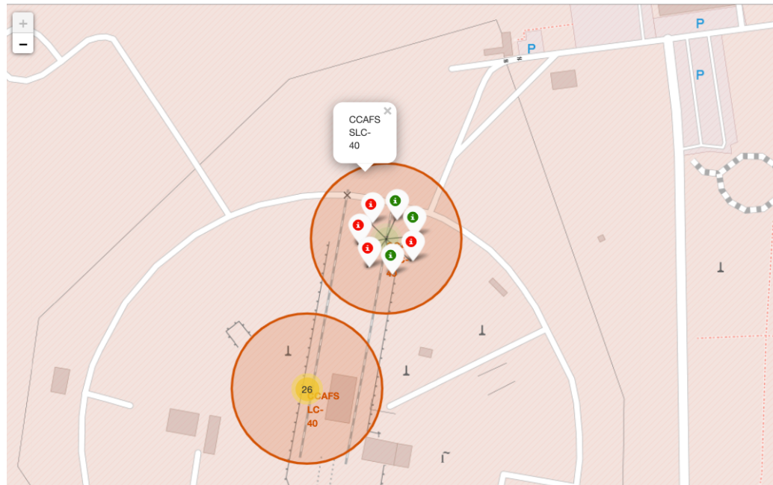
Launch Outcomes
The Green markers for successful launches
Red markers for unsuccessful launches
The launch site CCAFS SLC-40 has a 43% (3/7) success rate

Slide 37
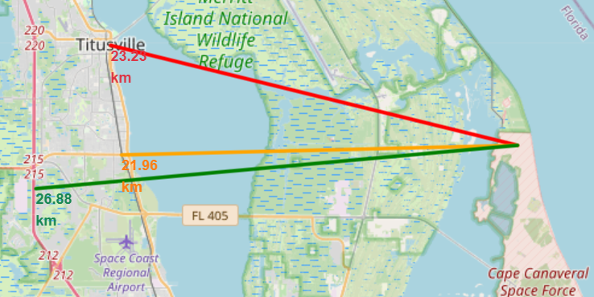
Distance to Proximities
CCAFS SLC-40
> 1Km from nearest coastline
21.96 Km from nearest railway
23.23 Km from nearest city
26.88 Km from nearest highway
Close proximity to Coasts
Away from Transportation and urban infrastructure which could be damaged by a failed launch, yet close enough to facilitate transportation of materials

Slide 38

Section 4

Slide 39
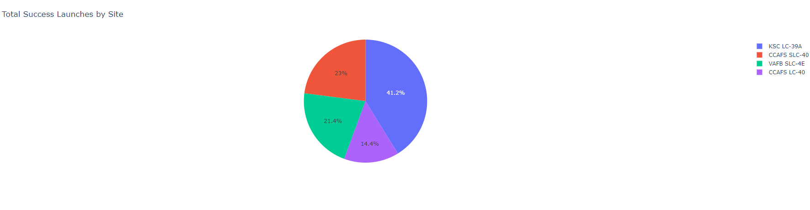
Launch Success by Site
Success as Percent of Total
KSC LC-39A has the most successful launches amongst launch sites(41.2%)

Slide 40
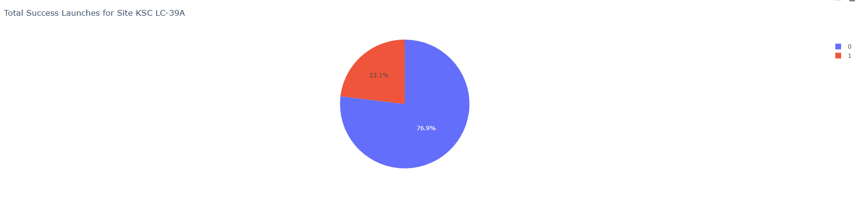
Launch Success ratio
Success percentage
KSC LC-39A has the highest success rate amongst launch sites (76.9%)
10 successful launches and 3 failed launches

Slide 41
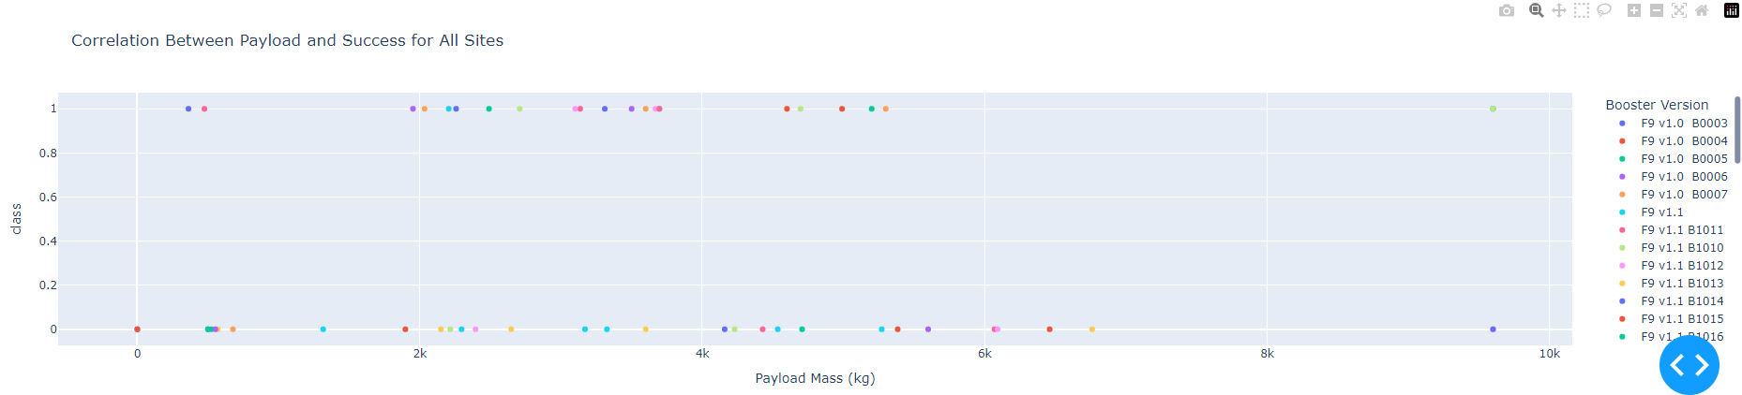
Payload Mass and Success
By Booster Version
Payloads between 2,000 Kg and 5,000 Kg have the highest success rate
1 indicating successful outcome and 0 indicating an unsuccessful outcome

Slide 42

Section 5

Slide 43
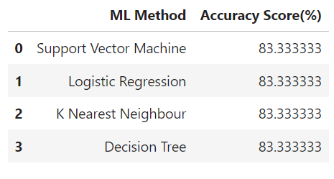
Classification Accuracy
All the models performed at about the same level and had the same scores and accuracy. This is likely due to the small dataset. The decision Tree model slightly outperformed the rest when looking at the best score
Best score is the average of all cv folds for a single combination of the parameters

Slide 44
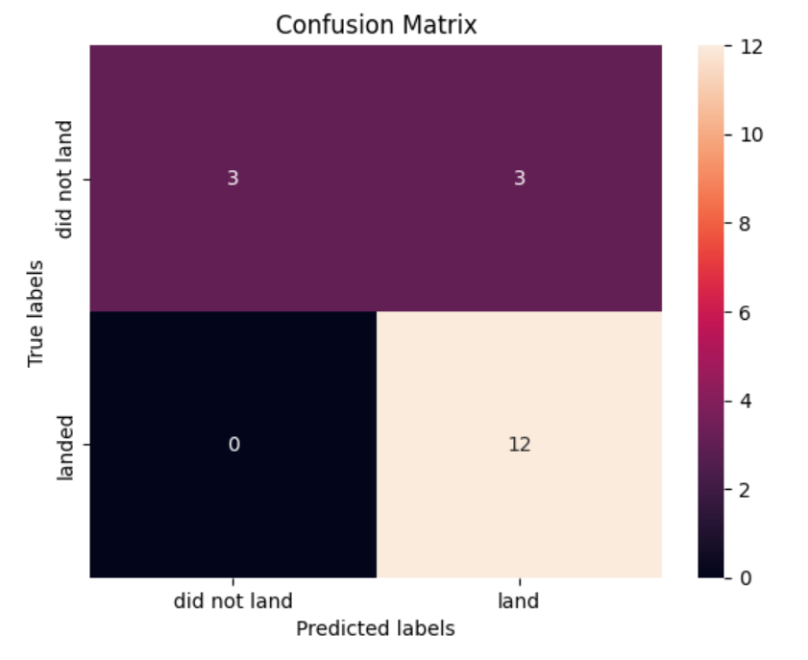
Confusion Matrix
Performance Summary
A confusion matrix summarizes the performance of a classification algorithm
All the confusion matrices were identical
The fact that there are false positives (Type 1 error) is not good
Confusion matrix Outputs:
12 True Positives
3 True negatives
3 False positives
0 False negative
Precision = TP/(TP+FP)
12/15 = 0.8
Recall = TP/(TP + FN)
12/12 = 1
F1 Score = 2*(Precision* Recall)/(Precision + Recall)
2*(8*1)/(8+1) = 0.89
Accuracy = (TP + TN) / (TP+TN+FP+FN)
(12+3)/(12+3+3+0) = 0.83

Slide 45
Equator: Most of the launch sites are near the equator, benefitting from the Earth’s rotational speed which provides a natural boos and reduces the need for extra fuel and boosters
Coast: All the launch sites are close to the coast.
Launch Success: The success rate of launches has increased over time
KSC LC-39A: This site has the highest success rate among launch sites with a 100% success rate for launches carrying payloads under 5,500 Kg
Orbits: Launches to ES-L1, GEO, HEO, and SSO have achieved a 100% success rate
Payload Mass: Across all launch sites, higher payload masses are correlated with higher success rates
Conclusions

Slide 46


